Slide 1


July 8 - 12 (* location*), 2019
Agenda: (*LINK*)
Add → FACILITATOR & Apprentice EMAILs @CODEVIRGINIA.ORG
Notes:
REMEMBER: change all the info highlighted in yellow - don’t forget the survey link on the last slide

Slide 2

MONDAY
Agenda: (*LINK*)

Slide 3
Introductions
Notes:
Intro facilitators and apprentices
Teachers - Do this at the tables unless the group is small enough to get through this in 10 -15 min

Slide 4
MONDAY’s Agenda
HW:
Introductions
Goals of Coaches Academy
What is Computer Science?
Programming in Scratch
Lunch
SOL Gallery Walk
Lesson: Computers, Computers Everywhere
HW: Journal Entry

Slide 5
Academy Goals - help you develop:
Knowledge of the new VA Computer Science SOLs
Coding using the Scratch programming language
An understanding of how to design and teach integrated lessons
An ability to plan and implement local computer science professional development activities
Awareness of resources and tools available to support both teacher and student learning
Notes:
(15 min)

Slide 6
Structure:
Summer - 4 in person days
October & March/April Saturday sessions
Nov - March weekly online sessions

Slide 7
In Person Activities:
Journaling, reflection and discussions
Hands on coding in Scratch
Group collaboration
Content presentations

Slide 8
Content:
Summer
SOL Overview
Coaching
Strands: Programming, Impact and Computer Systems
October & March/April Saturday sessions
Cybersecurity
Data and Analysis
Internet & Networking
Nov - March weekly online sessions - Integration & PD

Slide 9
In your journal:
What do you know about how children learn that you can use to help bring computer science to your school?
Notes:
(30 Minutes) Think - pair - share discussion
Journal 5 - 7 minutes
Discuss w/ partner 5 minutes
Table share 5-7 minutes
Whole room discussion

Slide 10
What is Computer Science?
Notes:
(30 min) Lesson - What is Computer Science?

Slide 11
Have you used Computer Science today?
Notes:
Ask folk to share out responses - if they can’t think of much → cell phones, cars
Goal - that technology is the lens through which we interact w/the world, solve problems and create

Slide 12
Defining Computer Science
The study of how we use computing technology to solve human problems.

Slide 13
“Computer science is the study of computers and algorithmic processes, including their principles, design, implementation, and impact on society”
(Tucker, 2006, p. 2).
Huh?

Slide 14
Computer Science
is just the technology we currently use to solve old human problems.

Slide 15
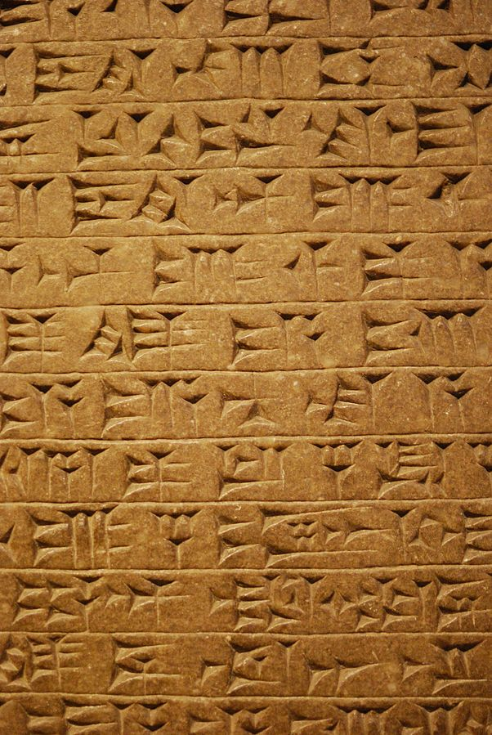
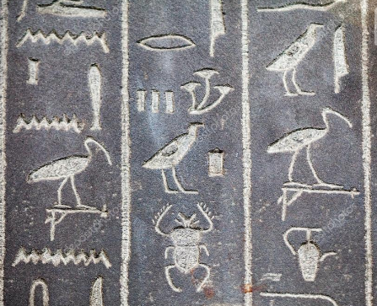
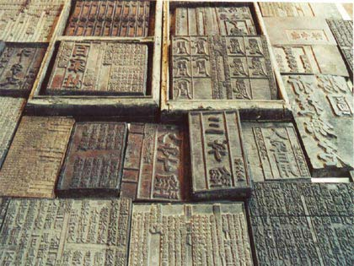
Example: Humans need to share knowledge & information
Notes:
Examples: Cuneiform from Mesopotamia (3200 BCE), Hieroglyphs from Egypt (3000 BCE) and Movable type from Ancient China (220 CE)

Slide 16
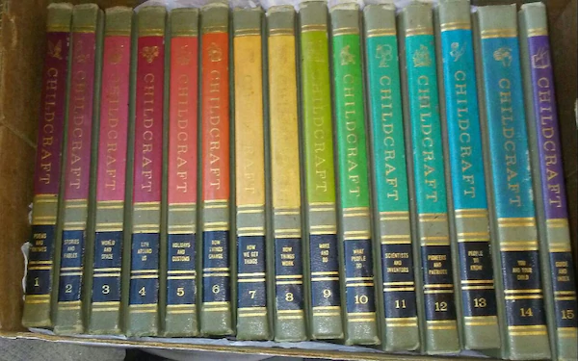
Example: Humans need to share knowledge & information
Notes:
Examples: Childcraft encyclopedias 1964

Slide 17
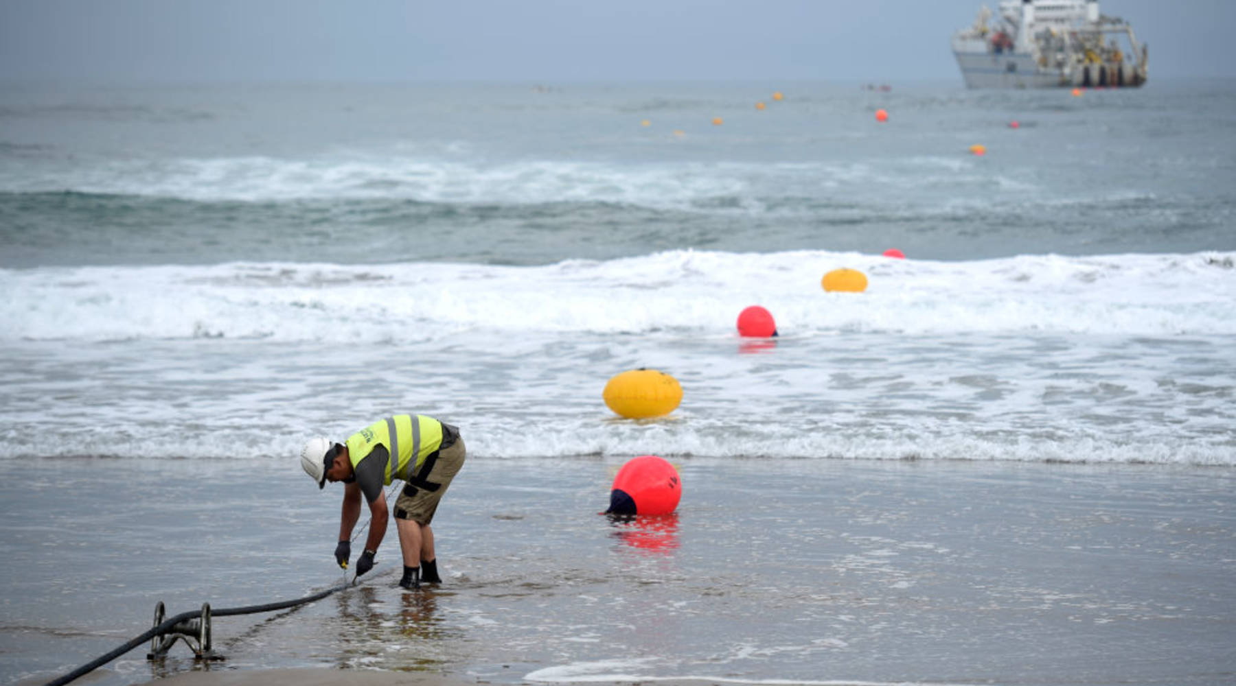
What is he doing?
Notes:
Guess - what is he doing?
Answer: Laying the undersea cables that connect the Internet

Slide 18
Example: Humans need to share knowledge & information
We now use the Internet to share knowledge & information.
Computer Science is the tool we use now, but the problem is as old as civilization.
Notes:
Examples: Childcraft encyclopedias 1964

Slide 19
Journal:
Brainstorm places in the K5 curriculum where students learn about how people share knowledge and information.
Notes:
8-10 min to brainstorm and share out

Slide 20
Computer Science ≠ (just) Coding
Code is the tool we use to DO computer science

Slide 21
Strands of Computer Science
Algorithms and Programming
Computing Systems
Cybersecurity (Virginia only)
Data and Analysis
Impacts of Computing
Networks and the Internet.
This Summer

Slide 22

Create Your Scratch Account
https://scratch.mit.edu/
Notes:
Guide them through creating a teacher account

Slide 23
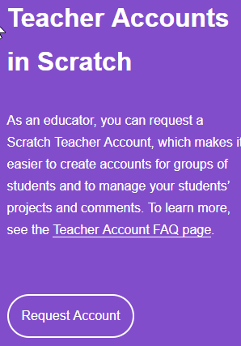

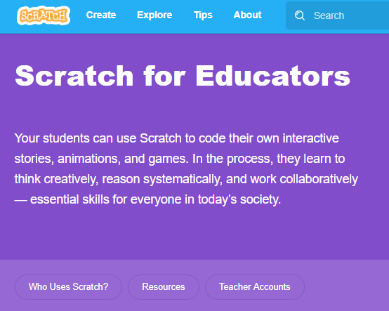
Create your teacher account
First
First
Then
Third
Second
These can take up to 24 hours to activate.

Slide 24
Try it out:
https://scratch.mit.edu/projects/162275313/
** all links are in the agenda doc

Slide 25
BREAK!
(Be back in 15 minutes)

Slide 26
Coding Lesson 1
Output, Input and Variables
Elementary Coaches Academy

Slide 27
Log into your Scratch account
https://scratch.mit.edu

Slide 28

Warm up
Open the starter File
http://bit.ly/BYTEC1
Run the program by clicking the flag icon

Slide 29
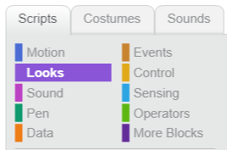
Warm up
Click the Looks menu
Add a command to make the cat say Goodbye

Slide 30
Warm up
Click the Looks menu
Add a command to make the cat say Goodbye

Slide 31
Warm up
Change the program to say:
Hello [your name]!
Notes:
Using the “say Hello! for 2 seconds” block edit the text to say hello [your name]”

Slide 32
Definition: Output
A way to get information out of a computer.
What examples of output did we see in this program?

Slide 33

Lab Lecture
Click the sensing menu
Add a question to your program
Notes:
This takes your answer and puts in the in the answer block to use as an output.

Slide 34
Definition: Input
A way to give information to a computer.
What examples of input did we see in this program?

Slide 35
Lab Lecture
Change your program so it:
Asks the user for their name
Prints “Hi there [name]”
Notes:
Using the join block under operators.

Slide 36
Lab Lecture
What if you want to:
Ask for the user’s first name, then ask for their last name and say:
Hi Ada Lovelace!
Notes:
Show them how to create a variable in the data menu
You must use multiple joins to make this work.
Set the variables to Answer because it changes answer when you ask it another question, so set answer to First after first question and then set answer to Last after second question.

Slide 37
Definition: Variable
A placeholder for a piece of information that can change.

Slide 38
Rules for Variable Names
can use letters & numbers but no spaces
must start with a letter
describe what it holds

Slide 39
Practice Exercises
http://bit.ly/2GL3Qqj
Mild - perfect for beginners
Medium - expanding your skills
Spicy - looking for a challenge?
Notes:
Give This 10 - 20 min depending on time left before lunch

Slide 40
Defining Code
Encoding - changing information from one form into another
Programming languages use commands to give the computer instructions. They encode what we want the computer to do into instructions it can understand.

Slide 41
Defining Code
Commands must be exact - they have to do the exact same thing every time.
This predictability is what allows us to design algorithms.

Slide 42
Tracing Code
Tracing code is reading through existing code and predicting what it will do.
It is important that students don’t just create programs from scratch, they also need to trace existing programs, just like in language arts they both write and read text.

Slide 43
Try it!
Read through this program (without running it) and predict what the output will be.
https://scratch.mit.edu/projects/319245287/
(* Link is in the agenda *)

Slide 44
LUNCH!
(Be back by 1 PM)

Slide 45
SOLs Gallery Walk
Divide into groups of 2 - 4
Each group gets a grade level and a strand
Make a T-Chart
Left Side: things in the SOLs that teachers current cover in some way. these are things currently happening in schools that create a starting place for teaching this topic.
Right Side: Things that are not at all being covered.
Notes:
(60 min) 45 min Gallery Walk, 15 min review structure of the SOLs

Slide 46
SOLs Overall Structure
K - 8 meant to be integrated into core instruction
Middle School elective created
High School three new electives created before AP level classes

Slide 47
Integrated Standards
An integrated curriculum is described as one that connects different areas of study by cutting across subject-matter lines and emphasizing unifying concepts. Integration focuses on making connections for students, allowing them to engage in relevant, meaningful activities that can be connected to real life.

Slide 48
Integrated Standards - First Grade
1.12 The student will identify and explain responsible behaviors associated with using information and technology. [Related SOL: HSS 1.10]
Civics - 1.10 The student will apply the traits of a good citizen by
a) focusing on fair play, exhibiting good sportsmanship, helping others, and treating others with respect;
b) recognizing the purpose of rules and practicing self-control;
c) working hard in school;
Etc.

Slide 49
Integrated Standards - Fourth Grade
Computer Science 4.8 The student will model how a computing system works including input and output, processors and sensors.
Science 4.3 The student will investigate and understand the characteristics of electricity. Key concepts include
a) conductors and insulators;
b) basic circuits;
c) static electricity;

Slide 50
Elementary - Coding Kindergarten
Kindergarten and first coding can be a group or whole class activity
either independently or collaboratively
And can be unplugged or on a computer:
either using a block based language or unplugged activities

Slide 51
Elementary - Coding First Grade
In first grade the language is the same:
either independently or collaboratively
And can be unplugged or on a computer:
either using a block based language or unplugged activities

Slide 52
Elementary - Coding Second Grade
In second grade the language shifts:
both independently and collaboratively
And can still be unplugged or on a computer:
using a block based language or unplugged activities

Slide 53
Elementary - Coding Third Grade
By third grade the language shifts:
both independently and collaboratively
And they must code on a computer:
using a block or text based language

Slide 54
BREAK!
(Be back in 15 minutes)

Slide 55
Lesson
Computers, Computers Everywhere
(from Exploring Computer Science )
Elementary Coaches Academy
Notes:
(60 min) 35 min for activity, 10 min review Bits, Nybbles & Bytes, 15 for content

Slide 56
Professional Learning Resources
This lesson is an example of a Nybble
Bits 10 - 15 min activities
perfect for warm ups and faculty meetings
Nybbles 30 - 45 minutes
planning period length activities
Bytes 1 - 2 hours
after school or to build a PD day

Slide 57
Megabyte
Combo of the bits, nybbles and bytes to make a whole day PD

Slide 58
Terabyte
The Elementary Coaches Academy!

Slide 59
Content Review - Computer Systems
Binary - Computers can only work with 1’s and 0’s (on/off)
All data and information stored in binary
Program commands (code) are listed in binary
We need to change information that WE understand to binary so the computer can process it

Slide 60
Computer Systems - Input Devices
Examples of input devices
Input devices take our information and change it to binary
Notes:
Ask the teachers to share out examples of inout devices - keyboard, mouse, camera, microphone, etc.

Slide 61

Computer Systems - Input Devices
Keyboard - hit the A key
There’s not a tiny A that moves into the computer
Each key is assigned a number A = 65
65 in binary is 1000001 - so the keyboard sends a set of electric pulses to send the binary of 65 to the processor
Notes:
Remind teachers that students so NOT need to change #s in and out of binary

Slide 62
Computer Systems - Output
Changes the binary back to a format we can understand
Screen, Speakers, Printers….

Slide 63
Computer Systems - Processor
“Brain” of the computer
Runs programs and manages memory
Input & output devices are “talking” to the processor

Slide 64
Content Review - Journal
How do the hardware input and output devices relate to the input and output commands in Scratch?
Notes:
Have them discuss as a table - then do a whole room discussion. Focus on relating the computer hardware to the commands available in Scratch

Slide 65
Homework and Survey
You’ll be assigned a grade level:
Review your assigned grade level Computer Science SOLs
For each core subject (English Math, Science & Soc. Studies) find 2 - 3 places where they overlap with the CS SOLs
Daily Survey (* ADD LINK *)
Notes:
Count off everyone K to 5 - each number is assigned that grade level’s SOLs

Slide 67
TUESDAY
Agenda: (*LINK*)

Slide 68
TUESDAY’s Agenda
Journal: Encoding
Model CS - Kid Bot
Equity and the Digital Native
Code - Lesson 2: Data Types and Number Calculations
Integrating Computer Science
Computer Science and English
Practices of Programming:Debugging
Homework and Survey

Slide 69
In your journal:
Where in the elementary curriculum are there examples of things being encoded?
Notes:
(30 Minutes) Think - pair - share discussion - capture ideas

Slide 70

Modeling Computer Science
CS Unplugged - Kid Bots
Notes:
(45 Minutes) Activity 30-45 min, Debrief 15

Slide 71
Review Homework
Discuss with your table - where did you find connections between CS and the core areas?
Are there any patterns - for example, are there places in Science across multiple grades where CS can fit?
Notes:
(30 min) 15 min tables share - could do posters - 1 corner for each subject
Then share out as a whole room, or gallery walk & add sticky notes
The science example - water cycle, moon phases...are all things that can be modelled with a loop

Slide 72
BREAK!
(Be back in 15 minutes)

Slide 73
Coding Lesson 2
Number Calculations and Data Types
Elementary Coaches Academy
Notes:
(45 min)
LINK: https://drive.google.com/drive/folders/1wBzcdhUecPGtr5dTaRAnhviHDi_AFdEs

Slide 74
Log into your Scratch account
https://scratch.mit.edu

Slide 75
Warm up
Open the starter File
https://scratch.mit.edu/projects/227504750/
Run the program by clicking the flag icon

Slide 76


Warm up
Click the Data menu
Add a command in the loop to make the length grow by 1 each turn.
https://scratch.mit.edu/projects/227505753/

Slide 77
Warm up
How do you clear the screen?

Slide 78
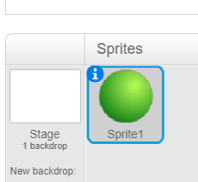
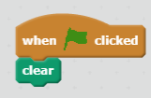
Warm up
Click the background → Stage
Select pen and add a clear command

Slide 79
Let’s Do the Math
The whole purpose of early computers was to do number calculations. They were really just big calculators.

Slide 80
Definition: Operations
The number calculations a computer program can do.
What examples of operations did we see in this program?

Slide 81
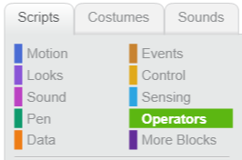
Lab Lecture
Click the operators menu
What math operators are built into Scratch?

Slide 82
Lab Lecture
Start a new program so it asks the user to enter a number:
Print the number multiplied by 20.

Slide 83
Lab Lecture
What happens when you enter a decimal?

Slide 84
Lab Lecture
What happens when you enter a word instead of a number?

Slide 85
Definition: Data Type
The kind of data a user types in
Numbers used for calculations
Words NOT used for calculations
Some books call these Strings

Slide 86
Lab Lecture
Change your program so it asks the user to enter a number:
Print the number divided by 10.
Do you get a decimal?

Slide 87

Lab Lecture
Change your program so it asks the user to enter a number:
Try the sqrt block.

Slide 88
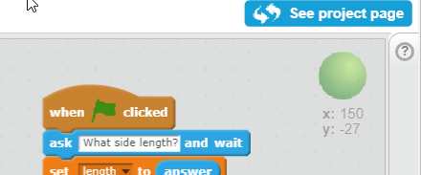
Lab Lecture
What does this do?
help menu

Slide 89
Lab Lecture
Input a number
Display the number MOD 10
Notes:
Show them how to create a variable in the data menu

Slide 90
Lab Lecture
What does MOD do?
Display the number MOD 5
Notes:
Show them how to create a variable in the data menu

Slide 91
Definition: MOD
Gives the remainder when doing division.

Slide 92
MOD is used for:
Patterns in programs (Pac Man)
Colors
Changing bases:
Time
Money
Checking if numbers divisible (even/odd)

Slide 93
Lab Lecture
Try MOD:
4
3
17
Notes:
Show them how to create a variable in the data menu

Slide 94
Lab Lecture
If we do MOD 4
How many possible answers?
Lowest?
Highest?
Notes:
Show them how to create a variable in the data menu

Slide 95
Practice Exercises
http://bit.ly/2Hma8Na
Mild - perfect for beginners
Medium - expanding your skills
Spicy - looking for a challenge?

Slide 96
Why Computer Science?

Slide 97


Slide 98
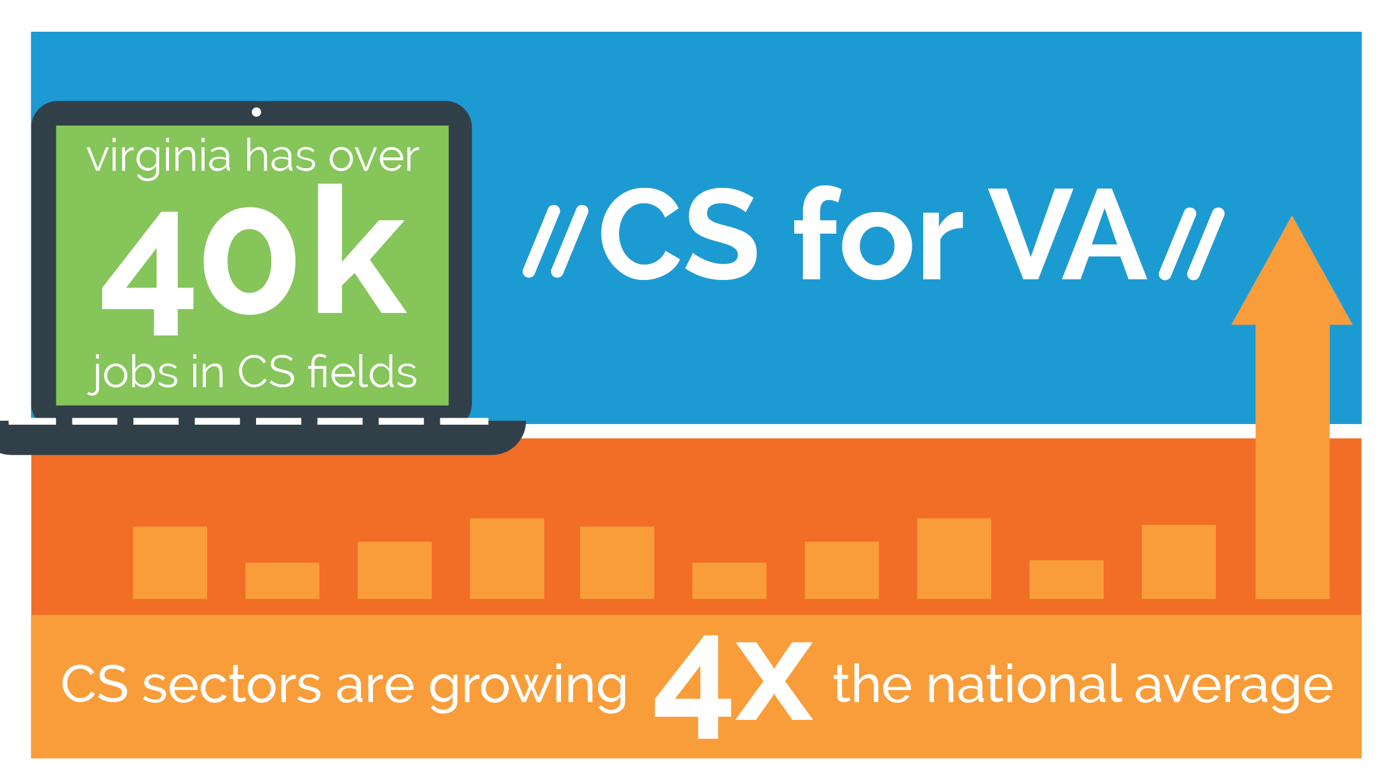
Notes:
Virginia’s #1 per-capita number is significant, too, when considering our neighbors’ placement on this list. Maryland and DC are two of the other four, and when adding the three as a regional hub for CS jobs, we’re bigger than NY and Texas, and neck-and-neck with Cali.

Slide 99
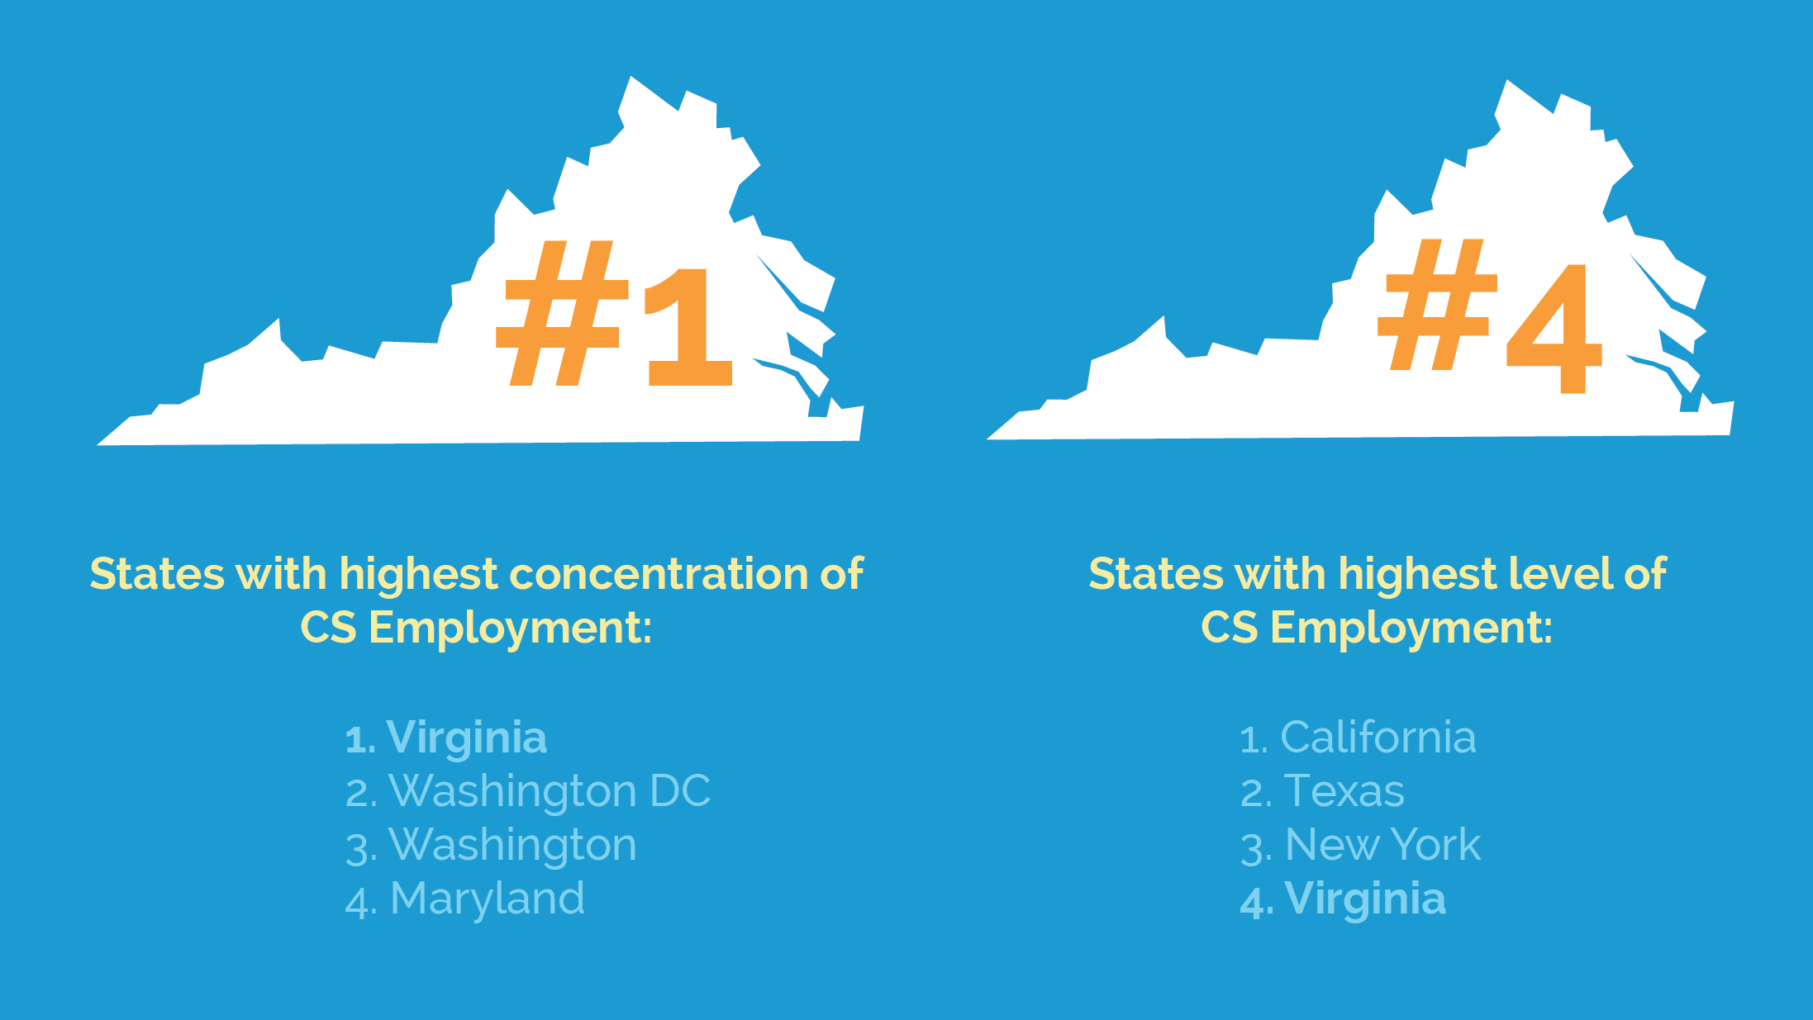
Notes:
1st per capita, 2nd total (overall)

Slide 100
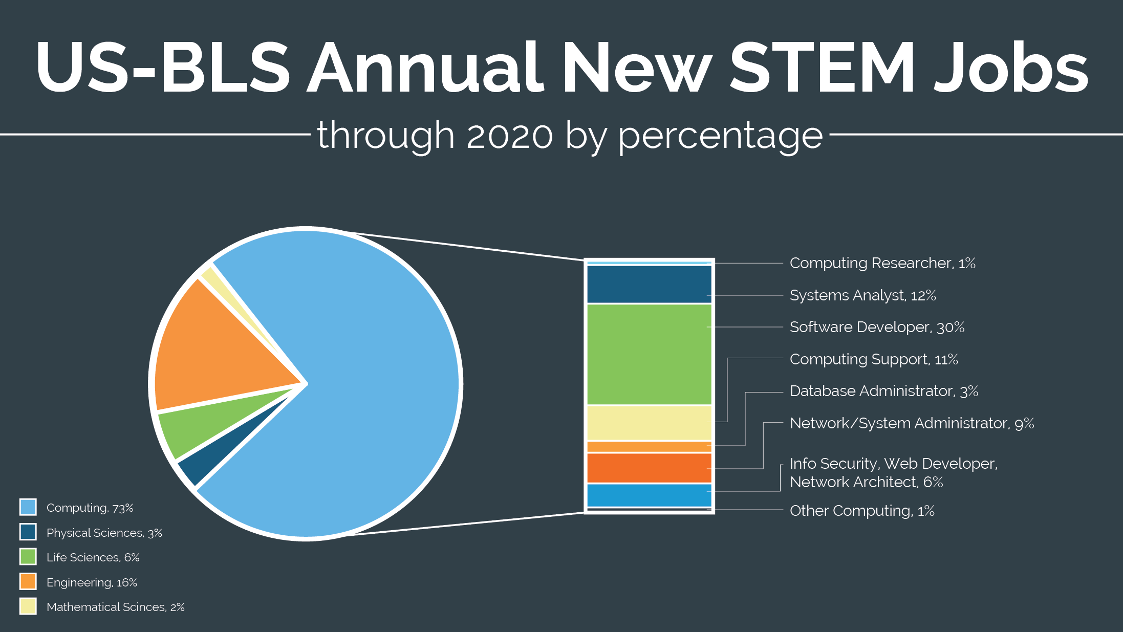
Notes:
This shows further the disconnect in conversation between stakeholders.
Computer Science is the study of how we communicate. Like literacy, but not purely like a single language. It is a way of thinking, of organizing thoughts and of communicating those thoughts in a It is how we pronounce STEM.

Slide 101
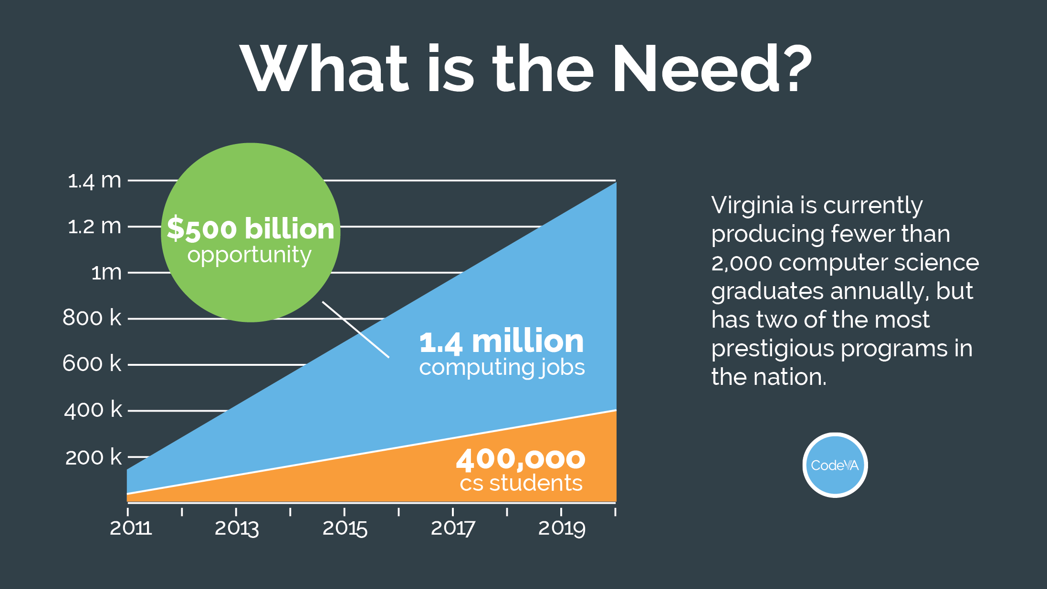
Notes:
The number of CS students is cumulative - Va is producing fewer than 2000 (1500 and not increasing) CS grads annually, and has two of the more prestigious programs in the nation. This number also includes community college and tech school grads. (Figure is national)

Slide 102
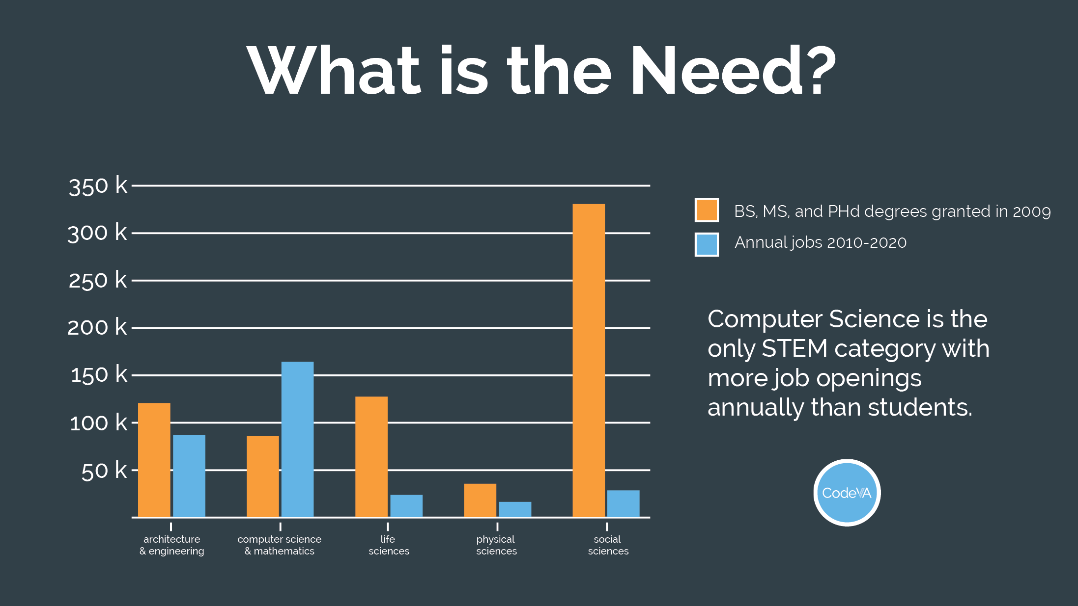
Notes:
CS is the only STEM field in which available jobs far exceed the number of available degree holders. (National)

Slide 103
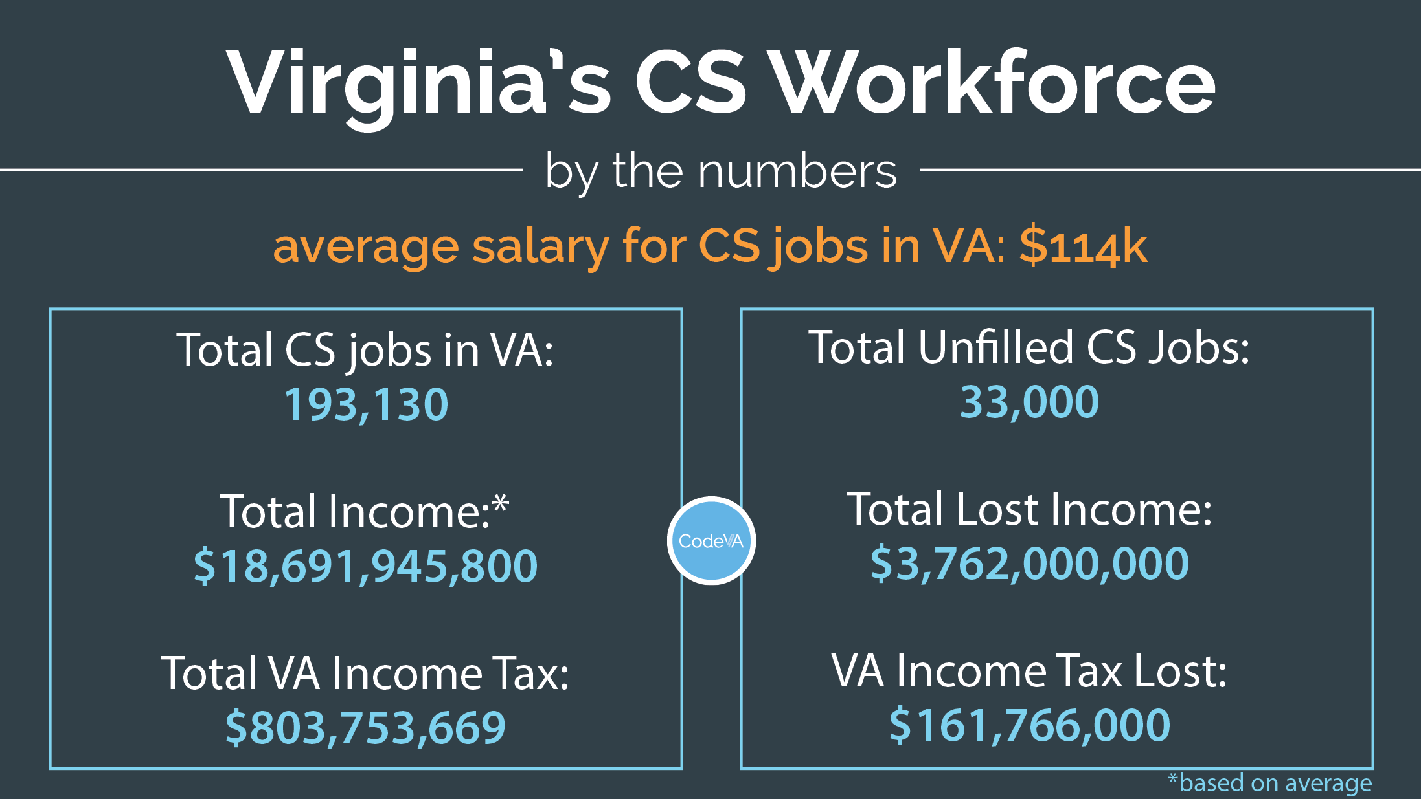
Notes:
Virginia and the national also suffers from miscommunication that historically existed between education, higher education, industry and policymakers. STEM and IT mean different things to all four. Traditional IT jobs (connecting printers to computers and running on-site servers) are no longer in-demand jobs, but K-12 still hears from industry of need for IT. IT to industry means CS literacy and specialized skills. Meanwhile, cybersecurity has added an entirely new layer of miscommunication, with many educators and policymakers assuming that “cyber” is not computer science, or that computer science is a small part of cyber.
Jobs in CS range in pay from “middle skills” jobs to Steve Jobs. - $15 hourly doing testing to $250,000 annual as a developer or other high-skills field and jobs in these fields may be posted as IT, computer science or related, or cyber.

Slide 104
Lunch!

Slide 105
Is the Digital Native Real?
As a table - Draw the digital native on poster paper
Notes:
Do a gallery walk
Discussion - what assumptions are we making about what our students know about technology? How do these assumptions block students from pursuing CS

Slide 106
Integrating Computer Science
Why Integration
Group discussion
challenges??

Slide 107
Integrating Computer Science
Computer Science and Computational Thinking
Deeply connected
Computational Thinking - thinking skills that when applied to real world problems create a solution that can be carried out by humans or machines.

Slide 108
Integrating Computer Science
Computational Thinking - is a way of thinking and understanding the world, a methodology
Computer Science - is its own discipline, you can major in CS, work as a Computer Scientist...
CT applies the tools and methods of CS to other areas, it is the bridge between computer science and other subjects

Slide 109
Integrating Computer Science
Computer Science vs Technology Integration
Not always related
CS - used to create new technologies and to support exploration and discovery
TI - use of existing technology to accomplish learning objectives

Slide 110
Integrating Computer Science
Computer Science Lessons can either:
Use technology
Tech integration practices might be helpful
Be completely unplugged
No need to consider tech integration
Either way, the focus is first on student outcomes
Then selecting appropriate learning activities & tools to maximize student learning

Slide 111
Lesson Planning Integrated Lessons
Steps
Decide what subject area to integrate w/CS
Identify Learning Outcomes
Select Level of Integration
Plan the lesson activities
Notes:
We’ll go through each step, then pair them up to try it

Slide 112
Integrating Computer Science - Step 1
Opportunities for integration
Each subject area has unique opportunities to incorporate computer science
From Monday’s HW - what are some areas that are good starting places for integration?
Notes:
Refer back to the HW from Monday - the patterns from different subject areas
Capture any other ideas not included on these slides

Slide 113
Integrating Computer Science - Step 1
English - Treating CS as a literacy and communication tool
ex: Conveying information is core to both subjects
Use programming for multimodal presentations
Analyzing media messages
We now experience these through Social Media
Tracing code parallels reading texts
Editing and Debugging
Research - recognizing other’s work

Slide 114
Integrating Computer Science - Step 1
Math - Where CS started
First computers were invented to automate calculations
Algorithms are used in both areas
Patterns
Support learning x & y coordinates - moving Sprites in Scratch
Applying math tools to programming - motivation

Slide 115
Integrating Computer Science - Step 1
Science - CS supports exploration & understanding
Modelling and simulation
Students create programs to model scientific principles
Cycles - water cycle, moon phases, metamorphosis...
Model with loops
Categorizing - ex: invertebrates vs. vertebrates
Model with if-statements

Slide 116
Integrating Computer Science - Step 1
Social Studies -
Civic responsibility and online behavior
Understanding how CS impacts society
CS is the current way we solve historic problems
ex: The underground Railroad relied on secret, encoded messages
We now communicate secretly, with privacy using tools like email and texts
Recognizing personally identifiable information online

Slide 117
Integrating Computer Science - Step 2
Identify Learning Outcomes
What existing curriculum, pacing guides and standards exist? How will these influence the lesson goals and outcomes?
Is there any content that may be confused because of integration? For example the term variable has different meanings in computer science, math and science.
How will students know what subjects are being covered?

Slide 118
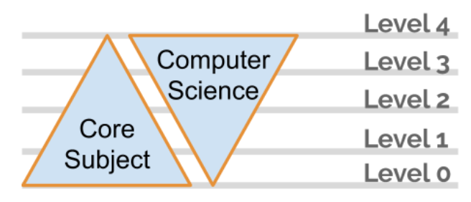
Integrating Computer Science - Step 3
Select Level of Integration
Level 0 No computer science content included in core content
Level 1 Computer science supports core content
Level 2 Computer science and core content coequal
Level 3 Core content supports new learning computer science
Level 4 Computer science content only

Slide 119
Integrating Computer Science - Step 3
Level o: No computer science
content included in core content
You are done!!
This is what teachers do everyday

Slide 120
Integrating Computer Science - Step 3
Level 1: Computer science supports
core content
No new CS content, only core subject
What computer science vocabulary will be needed for students to participate in this lesson?
If programming is to be included in the lesson, what specific programming skills will students need in order to be successful?
What supports will be offered for students lacking the required skills?
Will the computer science concepts be a part of the assessment of the learning?

Slide 121
Integrating Computer Science - Step 3
Level 2: Computer science and core
content coequal
New content in both CS and core content
CAUTION - this can mean a lot of new content
Use strategies to reduce cognitive load
Make connections between materials clear
Allow students opportunity to explore and create
Create opportunities for student collaboration

Slide 122
Integrating Computer Science - Step 3
Level 3: Core content supports
new learning computer science
New computer science content introduced
Core content being covered should be review of previous material.

Slide 123
Integrating Computer Science - Step 3
Level 4: Computer science
content only
How do you fit this into a packed schedule?
Are there opportunities to make connections to learning in core subjects

Slide 124
Integrating Computer Science - Step 4
Plan the Learning Activities
Is the computer science content best taught plugged or unplugged?
What technology or materials will be needed for this lesson?
How much time will the lesson take?
What kind of formative and summative feedback activities are included?
Are these activities accessible for all learners in the class?
What questions can be used to move from “just the facts, m’am” to higher order thinking?
Is there any content that may be confused because of integration? For example the term variable has different meanings in computer science, math and science.
Is the level of integration appropriate? Does it need to be adjusted?

Slide 125
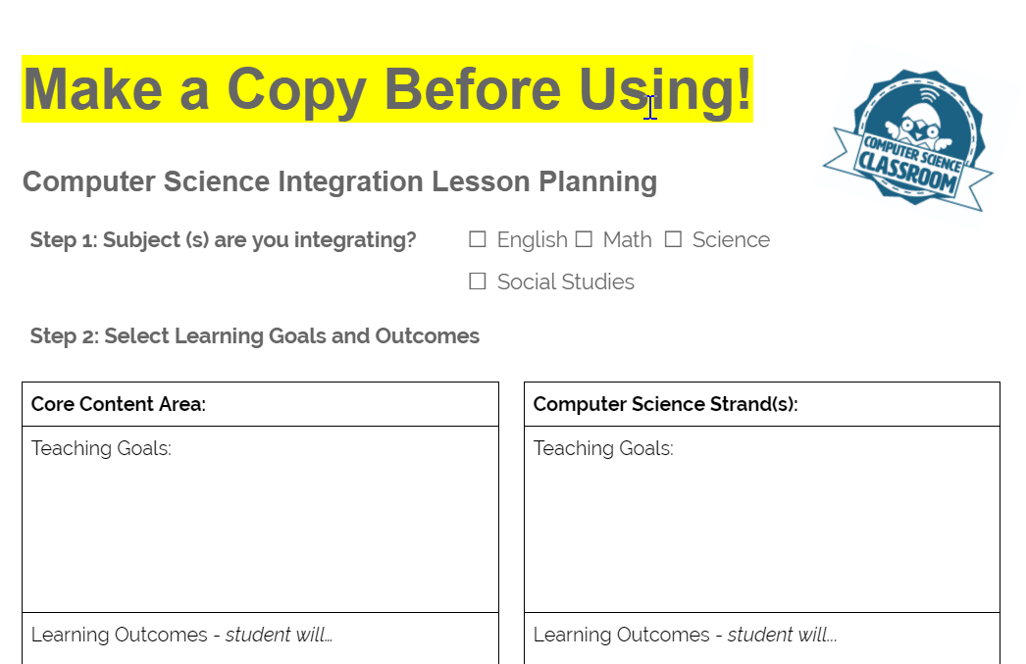
Integrating - You Try it!
With your group
Make a copy of the template (link in agenda)
Take a break as needed
Add them to the .
drive to share
Notes:
(30 min) Give the group about 30 min to finish
Group people 2 - 4 per group
Ask them to pick a grade level, and a core subject to integrate - You can assign these if needed

Slide 126
Crosswalk - CS and Language Arts
In your journal - look through the English and CS SOLs - what practices in English are reflected in Computer Science?
Notes:
(45 min) 15 minutes to read through, 30 minutes for whole group discussion
If the room is a bit “low energy” feel free to pair them up with someone from a different table to do the initial read-through

Slide 127
Debugging - Three types of errors in coding
Syntax errors
Logic Errors
Runtime Errors

Slide 128
Debugging - Syntax errors
The code will not run - something is entered incorrectly
Similar to grammar and syntax errors in student writing

Slide 129
Debugging - Logic Errors
The program runs, but the results are not correct
Similar to editing student writing for clarity

Slide 130
Debugging - Runtime Errors
These are errors while the program is running
EX: Dividing by zero will make a program crash
Scratch is built so this doesn’t happen
Not very common in K5

Slide 131
Debugging
Students debugging their programs is an opportunity to reinforce the editinging strategies used in their writing
Also is an opportunity for students to read each other’s code and help fix problems

Slide 132
Homework and Survey
Resources Rodeo
Select one of the integrated lessons from today to review
How could the lesson’s integration be deepened or the learning extended?
Any questions or comments
Collect 2- 3 resources to share that can support teachers implementing Computer Science
Please stick to free resources. add them to this http://bit.ly/2Xpy0N2
Daily Survey (* ADD LINK *)
Notes:
Count off everyone K to 5 - each number is assigned that grade level’s SOLs

Slide 134
WEDNESDAY
Agenda: (*LINK*)

Slide 135
WEDNESDAY’s Agenda
Journal: Barriers
Model CS - Error Detection
Instructional Coaching
Coaching Resources
Code - Lesson 3: Loops
Integrating Computer Science
Practices of Programming:Debugging
Computer Science and English
Homework and Survey
Notes:
Journal: Barriers to CS PD
Model CS - Error Detection
Instructional Coaching
Coaching Resources
Code - Lesson 3: Loops
Integrating Computer Science
Practices of Programming:Debugging
Computer Science and English
Homework and Survey

Slide 136
In your journal:
What assets and barriers do you anticipate when working with your faculty next year?
Notes:
(30 Minutes) Think - pair - share discussion - capture ideas

Slide 137
Modelling Computer Science
CS Unplugged - Error Detection
Notes:
(45 Minutes) Activity 30-45 min, Debrief 15

Slide 138
Instructional Coaching
Notes:
(45 min)

Slide 139
Reflection Question - in your journal
Remember a time in your life when you have worked with a GREAT coach. What made it great?
Notes:
Tabel share - find 3 commonalities
Collect from whole room

Slide 140
The goal - coaching should be:
Consultative
Support teachers in implementing Computer Science curriculum by providing different supports
Collaborative
Teacher should have a voice in setting learning & implementation goals
Reflective
Encourage teachers to try computer science, reflect on how it went, and improve over time
Notes:
Ask folks to respond: how can they do each of these?
Can count off tables 1 - 3 and assign each # one of the three areas - then share out as a whole group

Slide 141
In your Journal
Write out your personal definition of coaching.

Slide 142
On Monday we asked:
What do you know about how children learn that you can use to help bring computer science to your school?

Slide 143
And now:
What do you know about how adults learn that you can use to help bring computer science to your school?

Slide 144
Collect answers here:

Slide 145
Practice identifying feeling & connecting
Invite your conversation partner to share a pet peeve or a frustrating event.
How did you react?

Slide 146
Practice identifying feeling & connecting
What are the differences among pity, sympathy, and empathy?
How does empathy facilitate change?

Slide 147
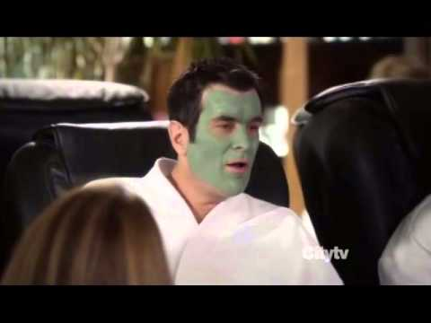

Slide 148
As a table:
What do you think is the MOST important skill for a coach to have?
Notes:
Then share out as a room

Slide 149
Types of Questions
Clarifying
Probing
Reflective/Appreciative
Set-Up/Demand

Slide 150
Clarifying
Yes or No
Factual
Quick
Goal: To truly understand the problem

Slide 151
Probing
Deeper thinking
Questions the presenters thoughts/feelings
NOT suggesting a solution
Goal: Help the presenter understand their own personal perspective

Slide 152
Reflective/Appreciative
Does not focus on weaknesses and problems to fix.
Focus is on strengths and assets
Goal: Uncover positive outcomes

Slide 153
Set-Up/Demand
Demand: prompt others to give us an answer we want to hear
“Those kids were really engaged, weren’t they?”
Set-up: catch another person in doing something wrong or poorly
“Did you finish that report on the assessment data?”

Slide 154
Set-Up/Demand
Stump: ask when we know the other person doesn’t know the answer but we do
“Do you know what the effect size is for growth-versus fixed-mindset feedback?”
Angry: disguised explanations of negative emotions
“Why don’t you give a little thought to what is best for the students?”

Slide 155
Avoiding judgement or solutions...
If you think there is a right answer..don’t ask it!
“Would students have done better if they had a rubric in advance?”
instead:
Try using verbs. What do you want? Need? Fear? Enjoy?
Why - a great starter and you can ask it multiple times in a row

Slide 156
Mastery vs. Compliance
Short-term compliance looks good and like a “win” for admin, but long term mastery of skill and adding strategies into repertoire leads to long-term results and student achievement
Notes:
Discuss with group - what are signs of mastery vs compliance for Computer Science?

Slide 157

Time to practice! (5 min)
The power of words…
1 minute share problem
1 minute clarifying questions
1 minute probing questions
2 minute reflection and find
solution
Notes:
Partner up!

Slide 158
Personal Coach Definition
Revisit the definition from earlier.
Add, modify, change as needed.

Slide 159
BREAK!
(Be back in 15 minutes)

Slide 160
If you have time you can go through these next slides and practice - they are optional

Slide 161
The Issaquah Protocol
Questioning strategy used to structure coaching.

Slide 162
The Issaquah Protocol
1. Presenter: Present a dilemma or problem you are working on.
(5-7 minutes)
What is involved?
Who is involved?
What goal are you trying to achieve?
What help do you want from the group?

Slide 163
The Issaquah Protocol
2. Clarifying Questions “Go-Round”: Information, meant to more fully understand what is going on; clarify any places of confusion.
(3-5 minutes)

Slide 164
The Issaquah Protocol
3. Active Listening: These are statements which restate what has been said. Like paraphrasing.
“I heard the presenter day…”
“What I am hearing is…”
Active listening helps the presenter hear what their problem sounds like to others and give them a chance to say what they really want.
(3-5 minutes)

Slide 165
The Issaquah Protocol
4. Interpretive Listening: So what?
“What this means to me is….”
“What I think this means is…”
“What i think is going on in this problem is…”
Interpretive listening helps the presenter hear what their problem sounds like to others and give them a chance to say what they really want.
(5-7 minutes)

Slide 166
The Issaquah Protocol
5. Presenter Check-In
Is the group hearing you correctly?
Is there anything you want to add?
Try and state the problem in 1-2 sentences based on the discussion so far.
(1 minute)

Slide 167
The Issaquah Protocol
6. Probing Questions: Help the presenter more deeply investigate their thoughts and feelings on the problem. Do not offer solutions or judgements.
(5-7 minutes)

Slide 168
The Issaquah Protocol
7. Presenter Response:
Which probing question made you think the hardest and why?
What new perspectives or thoughts do you have from the discussion?
Try and state the problem in 1-2 sentences based on the discussion so far.
(2 minutes)

Slide 169
The Issaquah Protocol
8. Group Suggestions:
“What if you…”
“One thing I might consider/try/do…”
“Have you thought of…”
“Is it possible to…”
(5-7 minutes)

Slide 170
The Issaquah Protocol
9. Presenter Response
What solution sounds best for you?
What short-term steps can you take to solve your problem?
Try and state the problem and solution in 2-3 sentences based on the discussion so far.
(2 minutes)

Slide 171
The Issaquah Protocol - Debriefing
What was it like to go through these steps in order?
What would have happened if some steps were skipped or questions asked in a different order?
What was the hardest part about this process?
What did you learn through this process?

Slide 172
The Issaquah Protocol
Now let’s try it
Notes:
Ask teachers to give a problem w/implementing CS
They are the PRESENTER, go back to first slide & go through steps

Slide 173
If you skipped - pick up again here

Slide 174
Coaching Resources
All the lessons are available through the online site for you to use with your staff.

Slide 175
Badges

Slide 176


Slide 177


Slide 178


Slide 179


Slide 180


Slide 181
How could you use the badges in your building?
add ideas here

Slide 182
BREAK!
(Be back in 15 minutes)

Slide 183
Coding Lesson 3
Loops
Elementary Coaches Academy
Notes:
LINK: https://drive.google.com/drive/folders/1wBzcdhUecPGtr5dTaRAnhviHDi_AFdEs

Slide 184
Log into your Scratch account
https://scratch.mit.edu

Slide 185
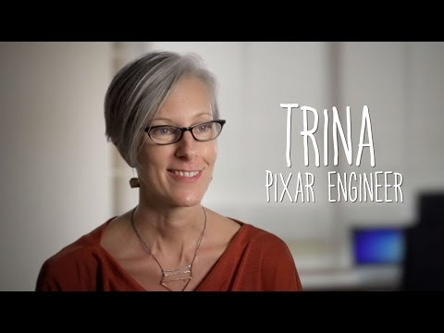

Slide 186
Warm up
Open the starter File
https://scratch.mit.edu/projects/230681049/
Run the program by clicking the flag icon

Slide 187
Warm up
What kind of loop does this use?
When will the loop stop?

Slide 188
Warm up
Change the program so the horse goes all the way across the screen.
Challenge: Make the horse turn around and
go back to the beginning

Slide 189
Definition: Loop
A loop is used to repeat commands in a program

Slide 190
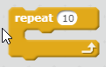
Definition: Repeat loop
This counting loop is used to repeat something an exact number of times.

Slide 191
Definition: Repeat loop
We use these when:
When there is a definite starting and ending point
You know how many times you want the loop to run

Slide 192
Lab Lecture
Add the parrot sprite and the forever loop
Make the parrot fly around randomly in the background

Slide 193

Definition: Forever Loop
This loop runs “forever”
...or until your program is stopped.

Slide 194
Lab Lecture
Discuss: How is the forever loop different than the repeat loop?

Slide 195
Lab Lecture
Change the program so the Forever Loop is a Repeat until.
Stop the parrot when the user hits the spacebar.

Slide 196
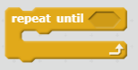
Definition: Repeat Until
This loop repeats until a certain condition is met.
Often used to react to user input or events.

Slide 197
Practice
Pick a core subject area (aka, Social Studies) and design a project that you could use with students to reinforce Loops.

Slide 198
Journal
Discuss - how can coding be used to reinforce core subject areas?

Slide 199
Lunch!

Slide 200
A Bit of Design!
Design a 10 - 15 PD activity you could use with your faculty. (unplugged please)
Base it on your integrated lesson from yesterday
How can you cover the CS content?
You will present them this later week
We will collect them in the Google Drive to share
BREAK! Take one when you need it
Notes:
(45 min)
USe the same groups as the integrated lesson

Slide 201
BREAK!
(Be back in 15 minutes)

Slide 202
Byte Activity - Mini Code A Thon
Notes:
Link is in spreadsheet -

Slide 203
HW: Finish the mini code-A-thon programs and share the links
Take the survey - please and thank you
(* LINK *)

Slide 205
THURSDAY
Agenda: (*LINK*)

Slide 206
THURSDAY’S Agenda
Journal: First Steps
Model CS - Sorting Networks
Planning Professional Learning
Code - Lesson 4: Conditionals & If Statements
Tools of Programming
Exploring Code.org
Resources Round-Up
Surveys and Next Steps

Slide 207
In your journal:
What are your first steps as a coach this summer and at the beginning of the school year?
Notes:
(30 Minutes) Think - pair - share discussion - capture ideas

Slide 208
Modelling Computer Science
CS Unplugged - Sorting Networks
Notes:
(45 Minutes) Activity 30-45 min, Debrief 15

Slide 209
Professional Learning Share Out
Notes:
(60 min)
Pair the groups up
Give each group 15 min to present to the other group
Do a whole room debrief - what worked? Any great ideas?

Slide 210
BREAK!
(Be back in 15 minutes)

Slide 211
Planning Professional Learning
Use the template to start your plan
http://bit.ly/328iNOM
(please make a copy)
Notes:
(30 Minutes)

Slide 212
Planning Professional Learning
What time is available for you to do training sessions?
How often can you meet?

Slide 213
Planning Professional Learning
Is there someone in your school/division you need to coordinate with - who?

Slide 214
Planning Professional Learning
Does your division have a committee working on computer science?
Are you on it? Who in leadership participates?
How is your division coordinating teacher PD for computer science?

Slide 215
Planning Professional Learning
What division/school documents need to be modified to include computer science?
Example: Pacing Guides

Slide 216
Planning Professional Learning
What resources do you have?
Example: Ozobots, iPads...

Slide 217
Planning Professional Learning
Time to work on your plan
We’ll report out at the end
Notes:
Think Pair Share

Slide 218
Coding Lesson 4
Conditionals - If Statements
Elementary Coaches Academy
Notes:
LINK: https://drive.google.com/drive/folders/1wBzcdhUecPGtr5dTaRAnhviHDi_AFdEs

Slide 219
Lunch!

Slide 220
Mini Code-A-Thon Gallery walk
Open your code-A-thon projects
Walk around and try the programs
Use sticky notes to leave comments, ask questions, give ideas
Notes:
(30 min)

Slide 221
Group Discussion
Discussion
Any questions about school planning?
Ideas to share?
Notes:
(30 min)

Slide 222
Review - Tools of Programming
Doc: https://drive.google.com/open?id=1DUd6m56MYOetxKod9aiHJ7rCgjHNUujj
Starter File https://scratch.mit.edu/projects/227511320/
What Tools of Programming are in the Grapher program?

Slide 223
BREAK!
(Be back in 15 minutes)

Slide 224
Code.org
Create Teacher Accounts
Go through the K5 curric
Discussion - where could some of these lessons be integrated?
Notes:
(30 min)

Slide 225
Resources Rodeo
Review the shared resources from Tuesday’s HW
Notes:
(30 min)

Slide 226
Coaches Academy - Next Steps
Please take the final survey
In person sessions in Sept or Oct
Online Nov - March
In persson sessions Mar or Apr
Notes:
(30 min)

